Slide 1
B2X 2차년도 3차 Pilot Study
Analysis of EEG data from the taVNS experiments
- N=20

Slide 2
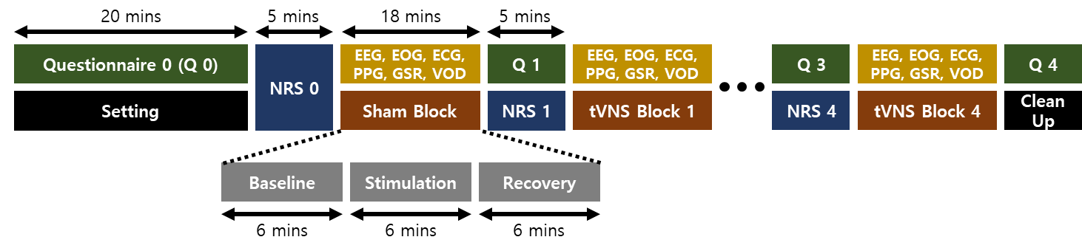
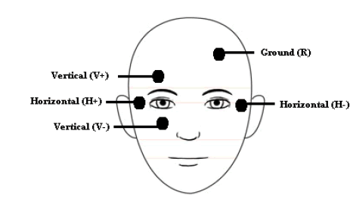
Experiment Protocol
BIOPAC 세팅
Sampling rate | 1000 Hz
ECG | Lead Ⅰ
PPG | 오른손 검지
GSR | 오른손 중지, 약지
VOD | 눈이 보이도록
Subject
Posture | Lying down
Eyes | Open
눈 ~ 태블릿 거리 | 50-100 cm
Frequency
20 Hz | 100 Hz
1 | 2
S020 | S100
N020 | N100
Fixed parameters
Electrode location | Left cymba concha
Pulse width | 200 us
Waveform | Biphasic symmetric | A
 | Biphasic | B

Slide 3
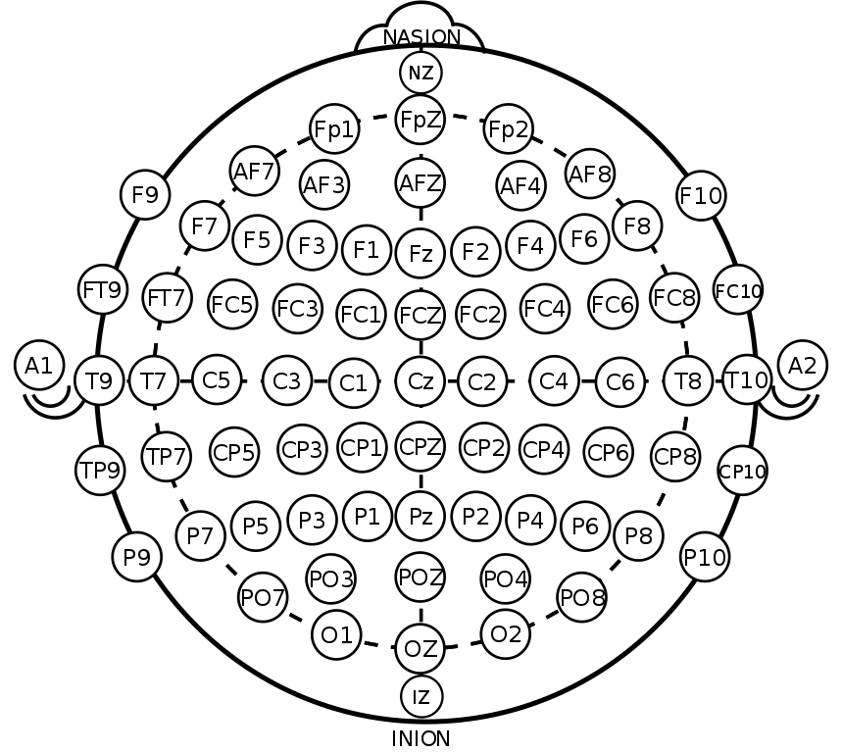
EEG Setting
0
Time
1 | 2 | 3 | 4 | 5 | 6 | 7 | 8
Empty | Fc5 | F7 | C3 | P3 | P7 | Cp5 | T7
9 | 10 | 11 | 12 | 13 | 14 | 15 | 16
F4 | Fc6 | F8 | C4 | P4 | P8 | Cp6 | T8
17 | 18 | 19 | 20 | 21 | 22 | 23 | 24
Pz | Poz | O1 | Oz | O2 | Fc1 | Fc2 | Cz
25 | 26 | 27 | 28 | 29 | 30 | 31 | 32
Cp1 | Cp2 | Fp1 | Fpz | Fp2 | Fz | A1 | F3
GND
REF
EEG 세팅
Sampling rate | 512 Hz
Gain | 239
33 | Reference | Gnd
flag | A2 | Afz

Slide 4
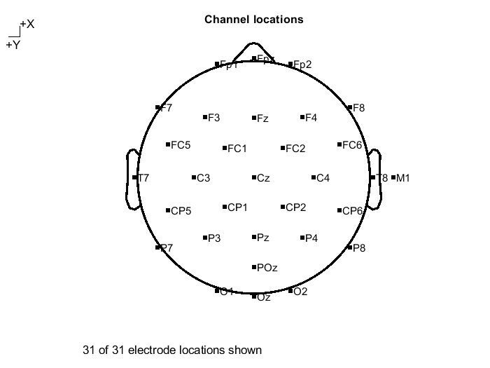
Framework of Analysis
Data Extraction
- Acquire 34ch cdf files (ch1: time, ch2: noise, ch34: flag)
cdf → txt: manually using telescan
txt → mat: python programming (ch1, ch2, ch34 are removed)
Result: .mat files that contain 31ch EEG data
2. .locs file preparation
Based on 10-20 system
32 ch
3. mat2set
Convert mat file to set file
4. Filtering
0.5Hz HPF
100Hz LPF
60Hz BRF

Slide 5
Framework of Analysis
5. Session dividing
session: base(6min), stim(6min), reco(6min)
Session dividing을 하지 않고 ICA를 하면, stim 구간의 노이즈가 반영되어 정확한 eye-artifact를 제거할 수 없음
Session 별로 eye-artifact를 제거하기 위해 session을 나누어 줌

